Slide 1

Identified Waste (Search Terms)
£146,076
Waste Spend Analysis
2025: £86,727 (47%) | 2026 Q1: £59,349 (49%) | Waste rate increasing
£46→£64
£441,336
8,959
Dental by Design | Prodent Group
Non-Brand CPA (YoY)
Total Spend Analysed
Total Conversions
Christopher Hoole
Google Ads Specialist | April 2026
christopherhoole.com
Data: 2025 (full year) + 2026 (Q1, Jan–Apr)

Slide 2
Executive Summary
2025 + 2026 (Q1)
£441,336
£146,076
£46 → £64
8,959
Total Spend Analysed
Search Term Waste (0 Conv)
Non-Brand CPA (YoY)
Total Conversions
Key Findings
Non-brand CPA has increased 40% year-on-year (£46 → £64) while monthly spend has nearly doubled.
£59,349 spent on zero-conversion search terms in Q1 2026 alone — 49% of all tracked search term spend generated no patient enquiries.
PMax: 81.7% of spend goes to Search, 6.3% to Display (£1,893/month for 2 conversions on mobile games). 69.3% of PMax search terms generate zero conversions (last 30 days).
PMax lead quality concern: top converting search terms are NHS/free seekers who will never become paying patients. Only 72 bookings from £30,026 spend — real booking CPA is £418.
Desktop CPA £92 vs mobile £56 (64% higher) with no device bid adjustments. 17 keywords above £150 CPA (£14,959).
This report identifies two types of waste: money that generated nothing (zero-conversion spend) and money that could work harder (high-CPA inefficiency). Both represent growth opportunity.
Christopher Hoole | christopherhoole.com | Confidential
2

Slide 3
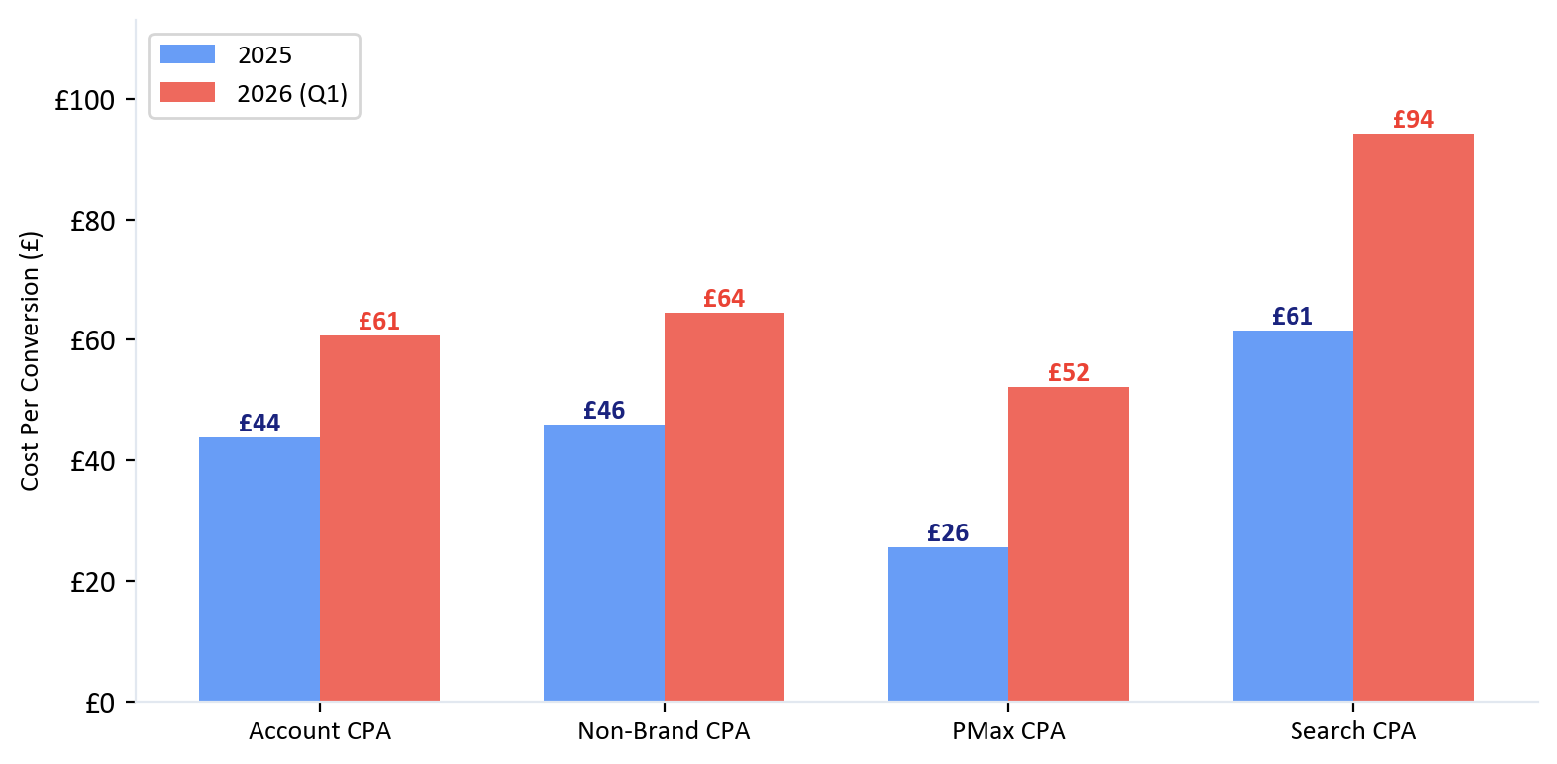
Year-on-Year CPA Comparison
2025 vs 2026
Non-brand CPA has increased across every campaign type and device
2025 (Full Year)
£46 Non-Brand CPA
£265,869 total spend 6,070 conversions 15 active campaigns
2026 (Q1, Jan–Apr)
£64 Non-Brand CPA
£175,467 total spend (annualised £526,400) 2,889 conversions 4 active campaigns
The Pattern
Spend has nearly doubled but CPA has risen 40%. The account is scaling aggressively but efficiency is declining — meaning more money is being spent to acquire each patient. This is the core issue the optimisations in this report address.
Christopher Hoole | christopherhoole.com | Confidential
3

Slide 4
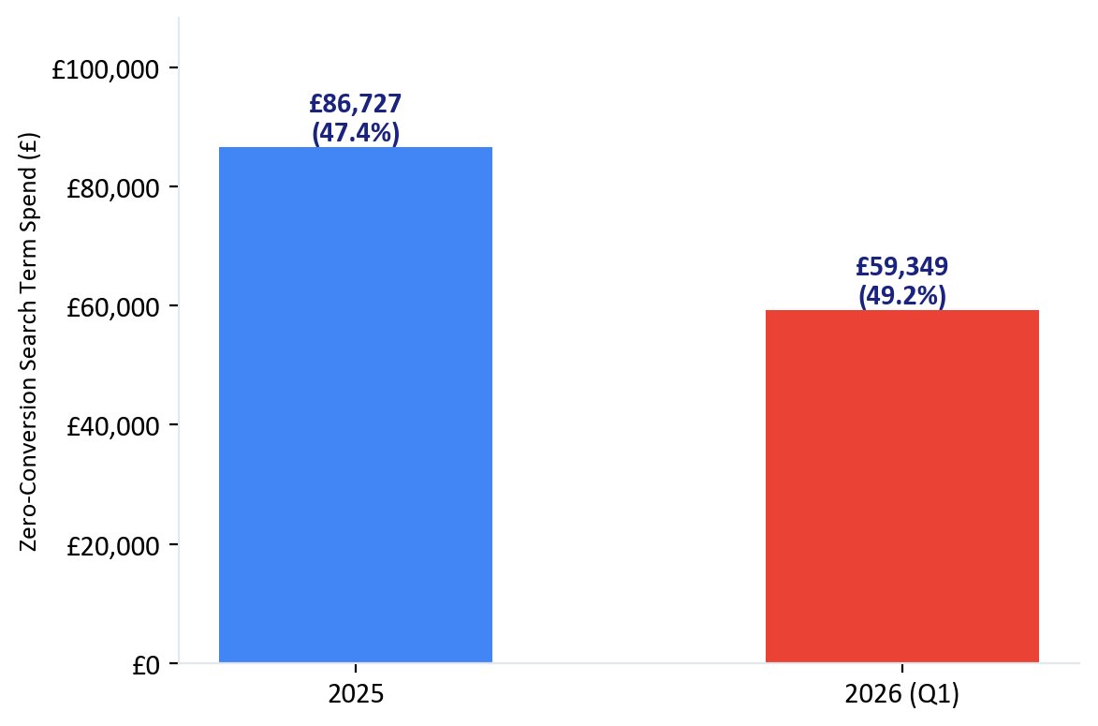
Search Term Waste
2026 Focus
£59,349 spent on zero-conversion search terms in Q1 2026 (49% of search term spend)
Search Term | Spend | Clicks | Campaign
best dental implants near me | £193 | 11 | Dental Implants Intent
dental implant clinics | £152 | 3 | Dental Implants Intent
dentist for implants near me | £147 | 9 | Dental Implants Intent
dental by design hammersmith reviews | £142 | 41 | Dental Implants Intent
tooth implant cost | £142 | 36 | Dental Implants Intent
full dental implants | £136 | 12 | Dental Implants Intent
full arch dental implants | £134 | 18 | Dental Implants Intent
teeth in a day | £130 | 10 | Dental Implants Intent
best implant dentist london | £124 | 13 | Dental Implants - Pmax
dental implants near me | £123 | 8 | Dental Implants Intent
dentists that do implants | £123 | 2 | Dental Implants Intent
all on 4 | £121 | 14 | Dental Implants Intent
implants dental | £106 | 9 | Dental Implants Intent
what is all on 4 dental implants | £106 | 13 | Dental Implants Intent
brighton implant clinic | £105 | 27 | Dental Implants - Pmax
Year-on-Year Trend
2025: £86,727 wasted (47% of ST spend) 2026: £59,349 wasted (49% of ST spend) The waste rate is increasing — nearly half of all search term spend now generates zero patient enquiries.
Christopher Hoole | christopherhoole.com | Confidential
4

Slide 5
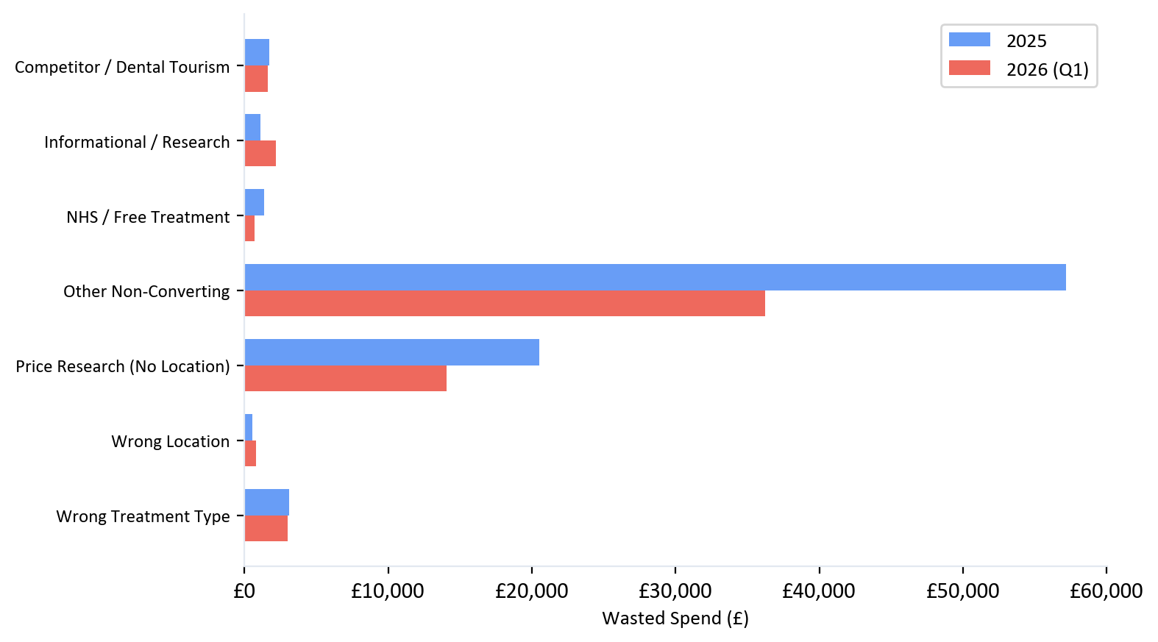
Waste by Category
2025 vs 2026
Zero-conversion search terms grouped by intent type — 2025 vs 2026
2025 vs 2026 Totals
Other Non-Converting: £57,191 → £36,260
Price Research (No Location): £20,540 → £14,078
Wrong Treatment Type: £3,112 → £3,001
Competitor / Dental Tourism: £1,724 → £1,629
NHS / Free Treatment: £1,378 → £706
Informational / Research: £1,092 → £2,217
Wrong Location: £547 → £812
"Other Non-Converting" (£57,191 in 2025, £36,260 in 2026) includes relevant dental terms that didn't convert — these need landing page and ad copy work, not just negative keywords. "Price Research" (£20,540 → £14,078) are blockable with negative keywords.
Christopher Hoole | christopherhoole.com | Confidential
5

Slide 6
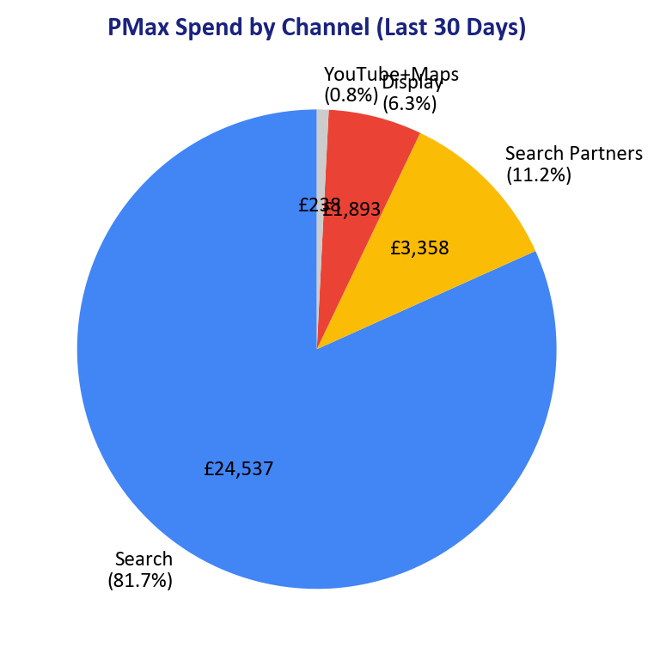
PMax Campaign — Where the Money Goes
Last 30 Days
81.7% of PMax spend is on Google Search. This is a Search campaign with Display waste bolted on.
£30,026
81.7%
£1,893
69.3%
93
PMax Spend (30 Days)
Goes to Google Search
Display: 2 Conversions
ST Waste Rate (30 Days)
PMax Negative Keywords
Channel | Spend | % of Total | Conv | CPA
Google Search | £24,537 | 81.7% | 311 | £79
Search Partners | £3,358 | 11.2% | 141 | £24
Display Network | £1,893 | 6.3% | 2 | £947
YouTube | £169 | 0.6% | 6 | £28
Maps | £69 | 0.2% | 1 | £69
YoY: PMax CPA Doubling
2025: £26 CPA (PMax ramping up — cheap early conversions) 2026 Q1: £52 CPA (+100% increase) Last 30 days: £65 CPA (still rising) As PMax scales, it reaches into less relevant territory. The 69.3% search term waste rate (up from 53% in 2025) confirms this.
Christopher Hoole | christopherhoole.com | Confidential
6

Slide 7
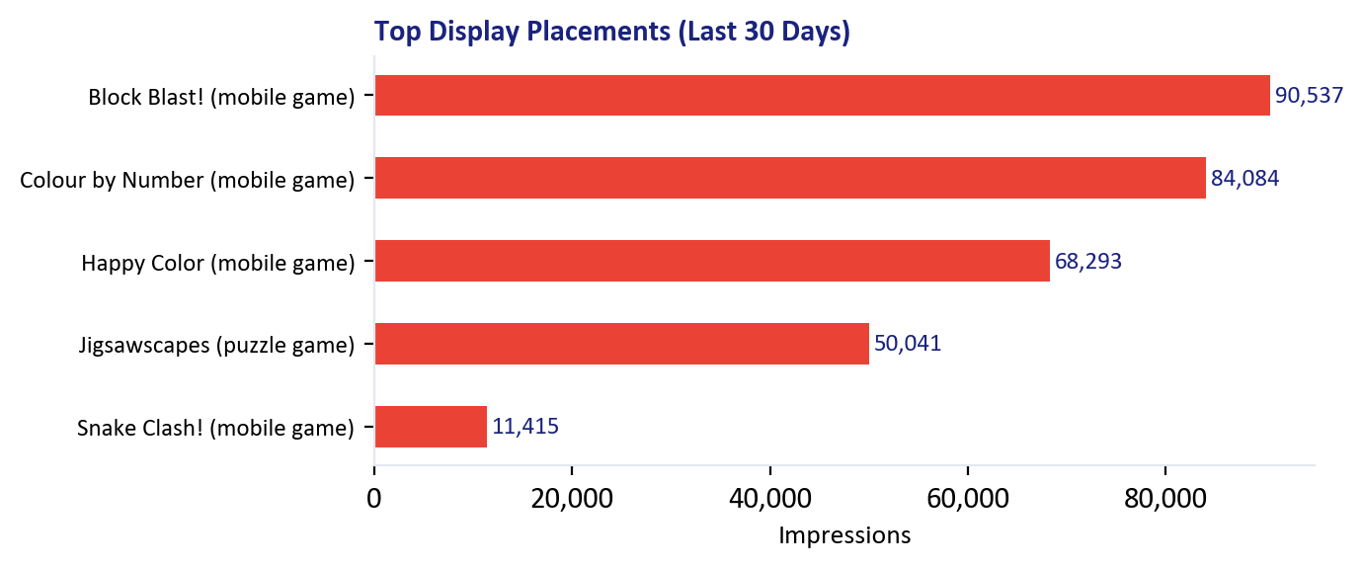
PMax — Display Waste & Lead Quality
Critical Finding
£1,893/month on mobile games + top converting terms are NHS/free seekers
Display: £1,893/month for 2 Conversions
4,700 mobile app placements, 1,048,422 impressions. Dental implant ads shown on Block Blast, Colour by Number, Happy Color, Jigsawscapes, Snake Clash, King James Bible app, and cricbuzz.com. These are not people researching dental implants. This is pure waste.
PMax Lead Quality — Top Converting Search Terms (Last 30 Days)
Search Term | Conv | CPA | Problem
how to apply for dental implants on the nhs | 31 | £12 | NHS/free seeker — not a DBD patient
free dental implants near me | 30 | £24 | NHS/free seeker — not a DBD patient
how to get free dental implants on nhs | 14 | £22 | NHS/free seeker — not a DBD patient
nhs dental implants over 60 | 5 | £11 | NHS/free seeker — not a DBD patient
free dental implants clinical trials near me | 4 | £11 | NHS/free seeker — not a DBD patient
Real Booking CPA: £418
Only 72 actual bookings from £30,026 spend. The “low CPA” is an illusion. PMax finds cheap conversions from people looking for free/NHS implants — they fill in forms but never book. The Dengro data confirms it: 13.3% lead-to-booking rate.
Christopher Hoole | christopherhoole.com | Confidential
7

Slide 8
Keyword Inefficiency
High-CPA Keywords
Zero-conv waste: £3,296 (2025) + £2,402 (2026) | High-CPA keywords: £4,118 (2025) + £14,959 (2026)
Angle 1: Zero Conversions
Angle 2: CPA Above £150
Keyword | Spend | Clicks
[all in one day dental implants] | £335 | 33
[low cost full dental implants] | £198 | 13
[cheap all on 4 dental implants] | £181 | 12
[all on 4 dental implants price] | £142 | 21
[get new teeth] | £113 | 14
[best way to replace teeth] | £97 | 17
[dental implants for the whole mouth] | £89 | 8
[getting full dental implants] | £84 | 7
Keyword | Spend | Conv | CPA
[dental replacement near me] | £5,224 | 31 | £170
[all on 4 implants] | £2,806 | 16 | £175
[dental implants close to me] | £2,463 | 15 | £160
[cheap full dental implants] | £796 | 4 | £199
[all 4 on one dental implants] | £778 | 3 | £259
[replace all teeth] | £472 | 2 | £189
[low cost dental implants in my area] | £321 | 2 | £161
[price of all on four dental implants] | £318 | 1 | £318
Zero-Conv Keywords: Both Years
High-CPA Keywords: Both Years
2025: 76 keywords, £3,296 wasted 2026: 53 keywords, £2,402 wasted These should be paused and budget redirected to converting keywords.
2025: 12 keywords at £150+ CPA, £4,118 spent 2026: 17 keywords at £150+ CPA, £14,959 spent The problem is growing — 3.6x more spend on high-CPA keywords in 2026.
Christopher Hoole | christopherhoole.com | Confidential
8

Slide 9
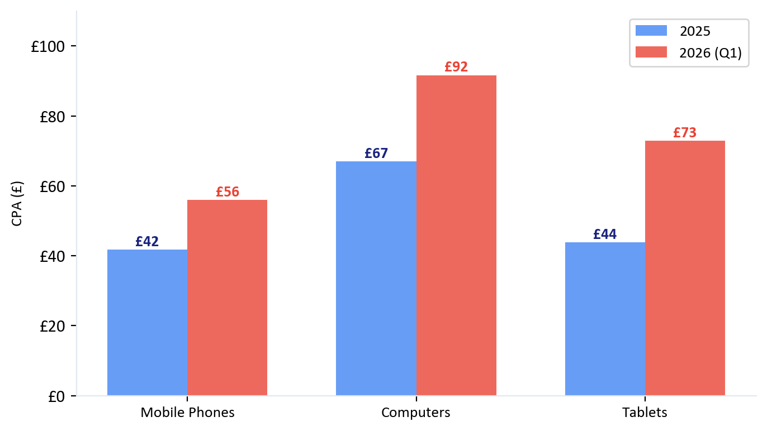
Device Performance
2025 vs 2026
No device bid adjustments despite significant and widening CPA gaps
Device | 2025 CPA | 2026 CPA | Change | Bid Adj.
Mobile | £42 | £56 | +34% | None
Desktop | £67 | £92 | +37% | None
Tablet | £44 | £73 | +66% | None
Desktop Premium Widening
Desktop CPA is 64% higher than mobile in 2026 (was 60% in 2025). The gap is growing.
Recommendation: Implement device bid adjustments. Reduce desktop bids by 20-25% and tablet bids by 30-40% to align spend with conversion efficiency. No adjustments exist anywhere in the account.
Christopher Hoole | christopherhoole.com | Confidential
9

Slide 10
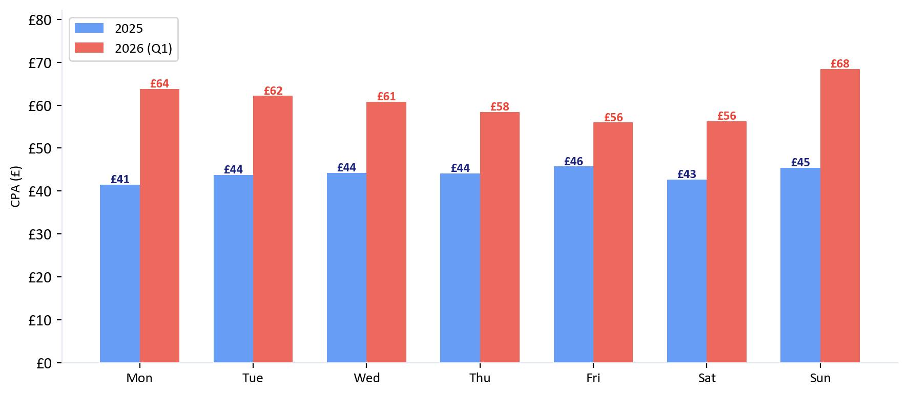
Day of Week Performance
2025 vs 2026
Sunday CPA: £45 (2025) → £68 (2026) — emerging as the clear waste day
2025: Tight Spread
Range: £41–£46 Day-of-week barely mattered. £5 spread across all days.
2026: Sunday Emerging
Range: £56–£68 Sunday at £68 is now 22% above Friday. CVR 2.5% (lowest).
Recommendation: Reduce Sunday bids by 15-20%. Sunday spent £89,867 in Q1 2026 at the worst CPA and CVR. No day-of-week bid adjustments exist.
Christopher Hoole | christopherhoole.com | Confidential
10

Slide 11
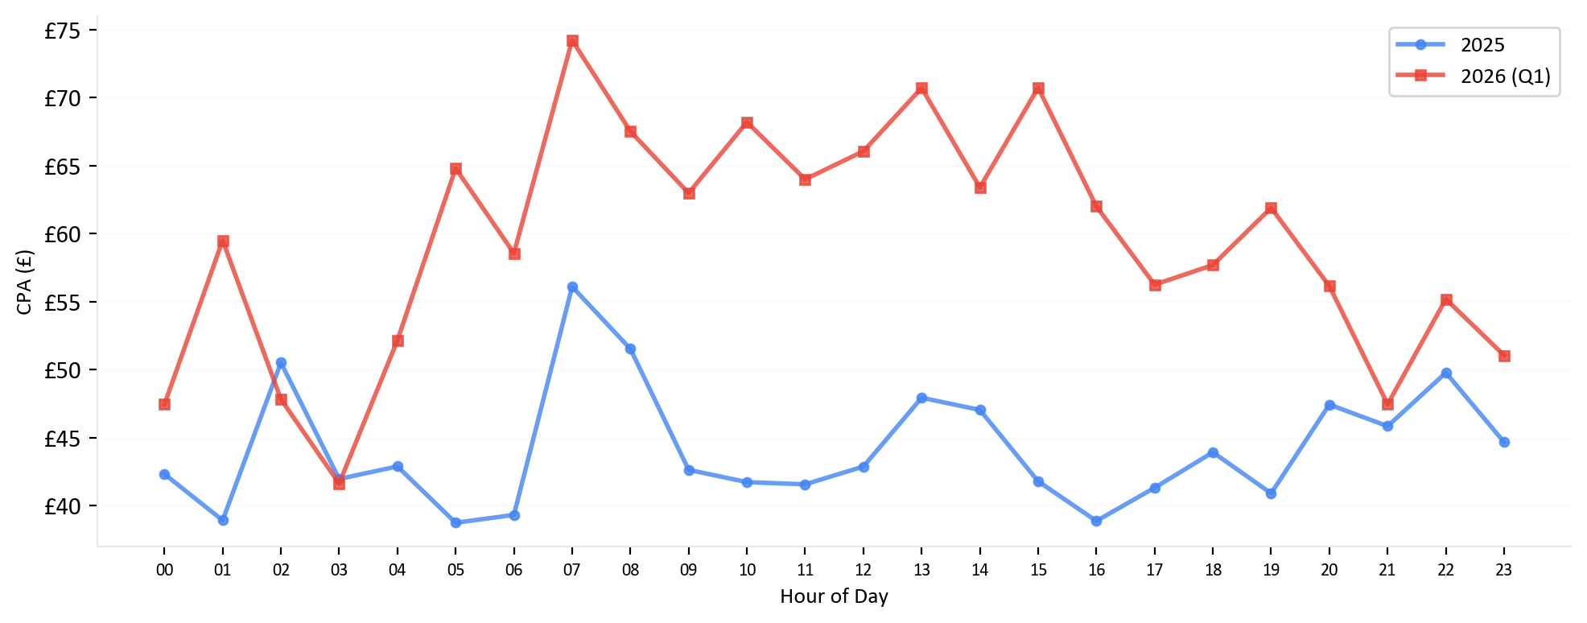
Hour of Day Performance
2025 vs 2026
7am worst in both years: £56 (2025) → £74 (2026) — +32% increase
2025 Range
2026 Range
Recommendation
Best: £39 CPA (5am, 4pm, 1am) Worst: £56 CPA (7am) Spread: £17
Best: £42 CPA (3am) Worst: £74 CPA (7am) Spread: £32 — nearly doubled
Implement ad schedule bid adjustments. Reduce 7-8am by 15-20%, boost 4-5pm by 10%. No scheduling exists in the account.
Christopher Hoole | christopherhoole.com | Confidential
11

Slide 12
Geographic Performance by Postcode
2025 vs 2026
Zero-conv postcodes: £2,211 waste (2025) + £2,088 waste (2026)
2025 — Worst CPA Postcodes (3+ conv)
2026 — Worst CPA Postcodes (3+ conv)
Postcode | Spend | Conv | CPA
SL2, England, United King | £712 | 4 | £158
SW1P, England, United Kin | £962 | 8 | £120
IG2, England, United King | £703 | 7 | £100
TW9, England, United King | £786 | 8 | £98
SE23, England, United Kin | £389 | 4 | £97
UB7, England, United King | £286 | 3 | £95
Postcode | Spend | Conv | CPA
N13, England, United King | £508 | 3 | £169
TW2, England, United King | £683 | 5 | £137
WD23, England, United Kin | £617 | 5 | £123
SM3, England, United King | £491 | 4 | £123
N17, England, United King | £361 | 3 | £120
W13, England, United King | £594 | 5 | £119
2026 — Best CPA Postcodes (3+ conv)
Recommendation: Postcode Targeting
Postcode | Spend | Conv | CPA
SM4, England, United King | £68 | 5 | £14
EN4, England, United King | £41 | 3 | £14
CM18, England, United Kin | £45 | 3 | £15
WD7, England, United King | £73 | 4 | £18
SW13, England, United Kin | £57 | 3 | £19
RM2, England, United King | £80 | 4 | £20
The data shows CPA ranging from £14 to £169 across London postcodes. Replace radius targeting with individual postcodes to unlock bid adjustments per area. Bid higher for postcodes near the clinic (W6, W12, W3) and lower for outer areas with high CPAs. All campaigns should share the same postcode targets — one unified geographic view across the account.
Christopher Hoole | christopherhoole.com | Confidential
12

Slide 13
Negative Keyword Gaps
Protection Gaps
784 account-level negatives use broad match — a risk to legitimate converting traffic
2,192
784
770
425
Total Negative Keywords
Broad Match (Risky)
Phrase Match
Exact Match
The Broad Match Problem
Recommended Framework
784 negative keywords at account level use broad match. Broad match negatives can block legitimate searches. For example, a broad negative for 'bridge' would block 'dental bridge implants' — a high-intent search. These need a full audit to ensure they're not blocking revenue.
Replace broad match negatives with phrase or exact match. Implement a structured 9-list system organised by word count and match type. Weekly search term reviews to keep the lists current. This gives precise control without accidentally blocking converting traffic.
Auto-Apply: 5 Recommendations Enabled
Google is automatically applying 5 recommendation types, including 'Remove conflicting negative keywords' (~20 times historically). This means Google has been removing negative keywords it considers conflicting — potentially re-opening waste that was deliberately blocked. Last auto-applied: 19 Feb 2026. Additionally, 'Remove redundant keywords' has been applied ~170 times — pausing keywords without human review. Recommendation: Disable all auto-apply except 'Use optimised ad rotation' (which is standard best practice).
Christopher Hoole | christopherhoole.com | Confidential
13

Slide 14
Total Waste Summary
Two Angles
Angle 1: Money That Generated Nothing
Angle 2: Money That Could Work Harder
£59,349 in Q1 2026 (search terms with zero conversions)
High-CPA keywords: £4,118 (2025) + £14,959 (2026) at 2-5x account average
Zero-conv search terms (2026) £59,349 49% of ST spend
Desktop: £67→£92 vs mobile £42→£56 Gap widening No bid adjustments
Zero-conv keywords (2026) £2,402 53 keywords
Sunday: £45→£68 CPA (worst day both years) Emerging problem No schedule adjustments
Zero-conv search terms (2025) £86,727 47% of ST spend
High-CPA keywords: 12→17 at £150+ £19,078 total Bid reduction needed
Zero-conv keywords (2025) £3,296 76 keywords
Geo: worst postcodes £120-169 CPA vs best £14-29 5-10x range Switch to postcodes
Combined: £151,774 in zero-conversion waste across the data period, plus significant efficiency gaps in device, schedule, geo, and keyword bidding.
Important Note: Conversion Tracking
These numbers use the conversions reported in Google Ads, which include Dengro offline leads (4,663), form submissions, phone calls, quiz completions, and several soft signals (booking clicks, phone clicks, WhatsApp clicks). If soft signals are excluded, the true CPA is higher and the efficiency gaps are wider. A conversion tracking audit is recommended as part of Report 2: Account Structure & Issues.
Christopher Hoole | christopherhoole.com | Confidential
14

Slide 15
What's Next
Report 2: Account Structure
Quick Wins
Conversion tracking audit, bid strategy analysis, Quality Scores, ad copy, and the structural issues driving CPA higher.
Immediate actions to reduce waste and improve efficiency
1. Block NHS/free seekers from PMax
2. Total negative keyword overhaul
£46→£64
8
Report 2
3. Add Display exclusions to PMax
CPA Trend (YoY)
Quick Win Actions
Coming Next
4. Implement device bid adjustments
5. Implement day + hour bid adjustments
6. Review 17 high-CPA keywords (£150+)
7. Disable auto-apply for negative keyword removal
8. Tighten geo: radius → postcodes

